Slide 1
Python Capstone Project
OTP VERIFICATION SYSTEM
Name : Santhosh kumar Ciliveru (S7946)

Slide 2
Challenge Description
Create a Python-based OTP verification system that generates a unique 6-digit code sent to users via email. Users input the OTP for validation, granting access if it matches the generated code. Deny access if the codes don't match.

Slide 3
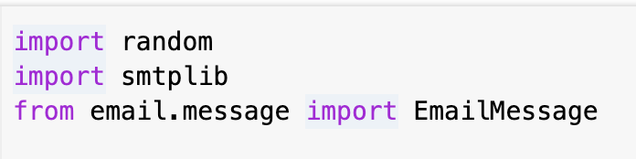
Modules
The smtplib module is used to send emails using the Simple Mail Transfer Protocol (SMTP). It allows to connect to an SMTP server, and send emails programmatically.
email.message is a module in Python's standard library that provides classes and functions for creating and manipulating email messages.
Random is a module in Python that provides functions for generating random numbers.

Slide 4
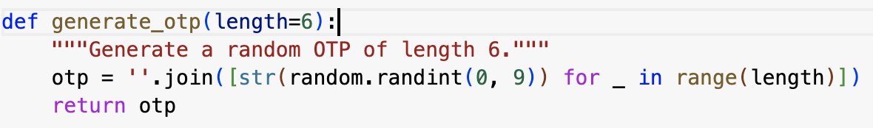
Code Explanation: generate_otp Function
Function purpose:Generate a random OTP.

Slide 5
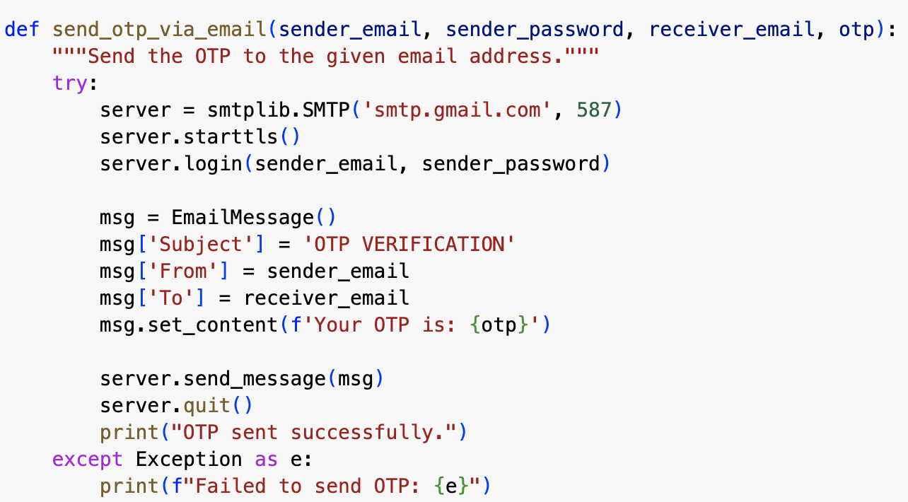
Code Explanation: send_otp_via_email Function
Function Purpose: Send OTP to
the user's email.
try : it is used to catch any errors
During the email sending process

Slide 6
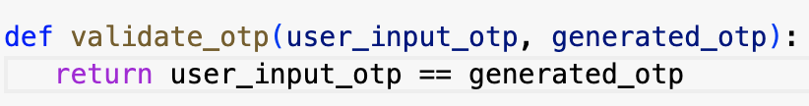
Code Explanation: validate_otp Function
Function purpose: Validate the OTP entered by User

Slide 7
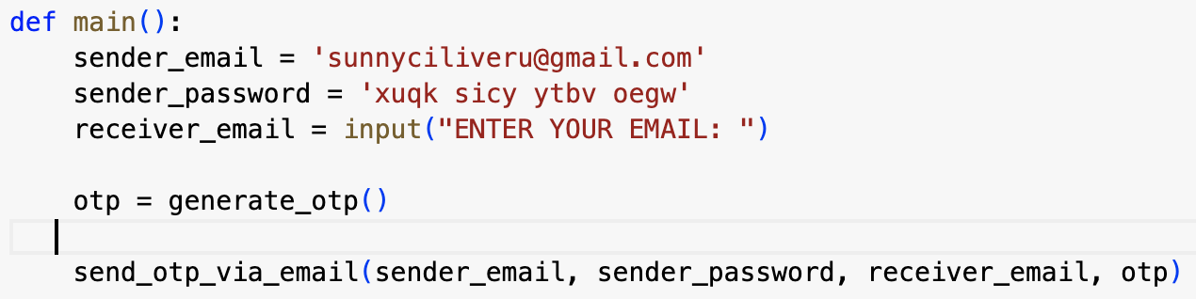
Code Explanation: main Function
Function purpose: Controlling the main flow of the OTP verification system

Slide 8
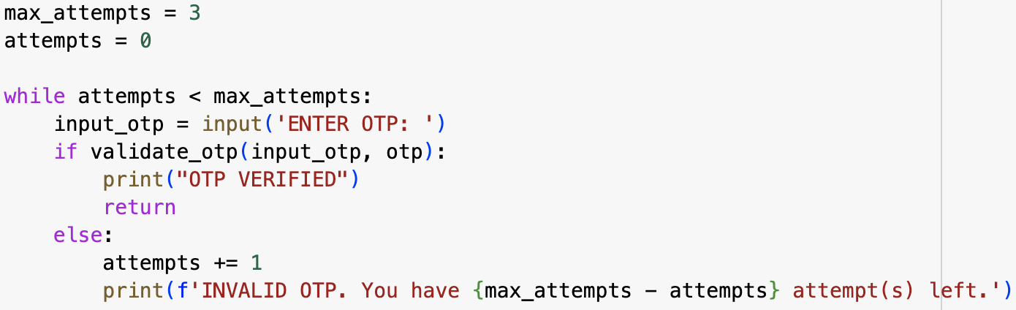
Code Explanation: While loop
bb

Slide 9


